Slide 1
Azure DevOps
Training
Notes:
Walk through Azure DevOps Overview Section.
Overview
Dashboards
Wiki

Slide 2

Agenda
What is DevOps?
What is Azure DevOps?
Azure DevOps Overview
Overview
Dashboards
Wiki
Azure DevOps Boards
Work Items
Boards
Backlogs

Slide 3



James Wasson
Lead Platform Services Engineer – Enable Midstream Partners
DevOps Institute Ambassador – DevOps Institute
Experience:
10 years in IT Operations
Technical Trainer
3 Years with Azure DevOps

Slide 4
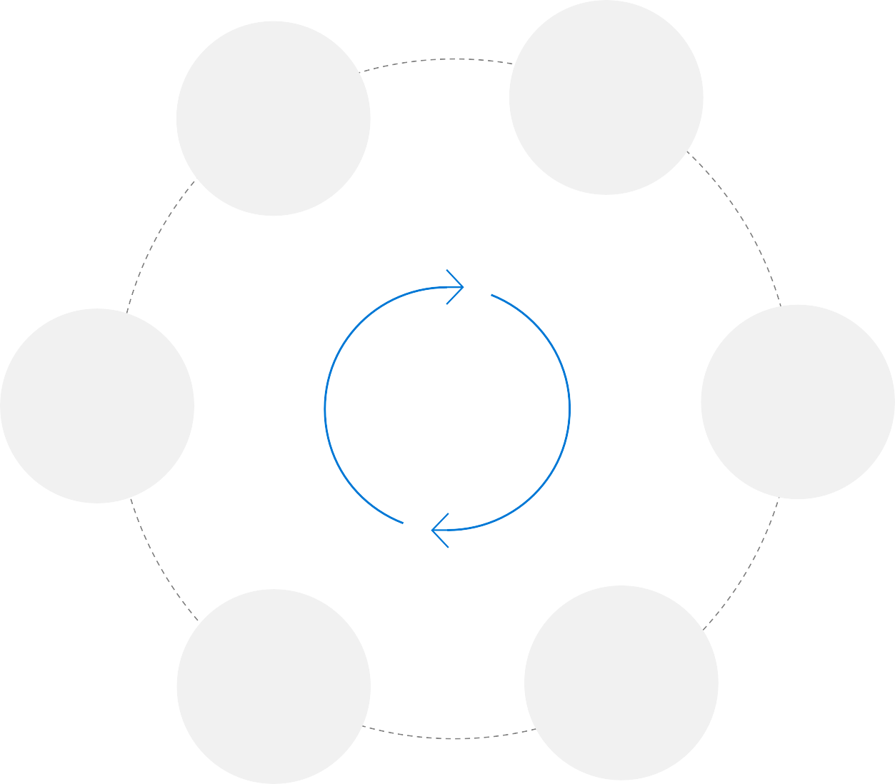
What is DevOps?
People. Process. Products.
Build & Test
Deploy
“
DevOps is the union of people,
process, and products to enable continuous delivery of
value to your end users. ”
Develop
Continuous Delivery
Operate
Plan & Track
Monitor &
Learn

Slide 5
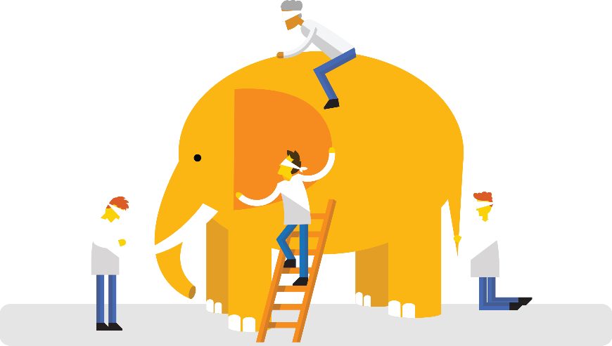
What is Azure DevOps?
Azure DevOps is a Microsoft product that provides version control, reporting, requirements management, product management, automated builds, testing and release management capabilities.
It covers the entire application lifecycle, and enables DevOps capabilities.
It’s DevOps!
It’s DevOps!
It’s DevOps!
It’s DevOps!

Slide 6





Azure DevOps
Azure Boards
Deliver value to your users faster using proven agile tools to plan, track, and discuss work across your teams.
Azure Pipelines
Build, test, and deploy with CI/CD that works with any language, platform, and cloud. Connect to GitHub or any other Git provider and deploy continuously.
Azure Repos
Get unlimited, cloud-hosted private Git repos and collaborate to build better code with pull requests and advanced file management.
Azure Test Plans
Test and ship with confidence using manual and exploratory testing tools.
Azure Artifacts
Create, host, and share packages with your team, and add artifacts to your CI/CD pipelines with a single click.

Slide 7
Azure DevOps
Overview
Notes:
Walk through Azure DevOps Overview Section.
Overview
Dashboards
Wiki

Slide 8
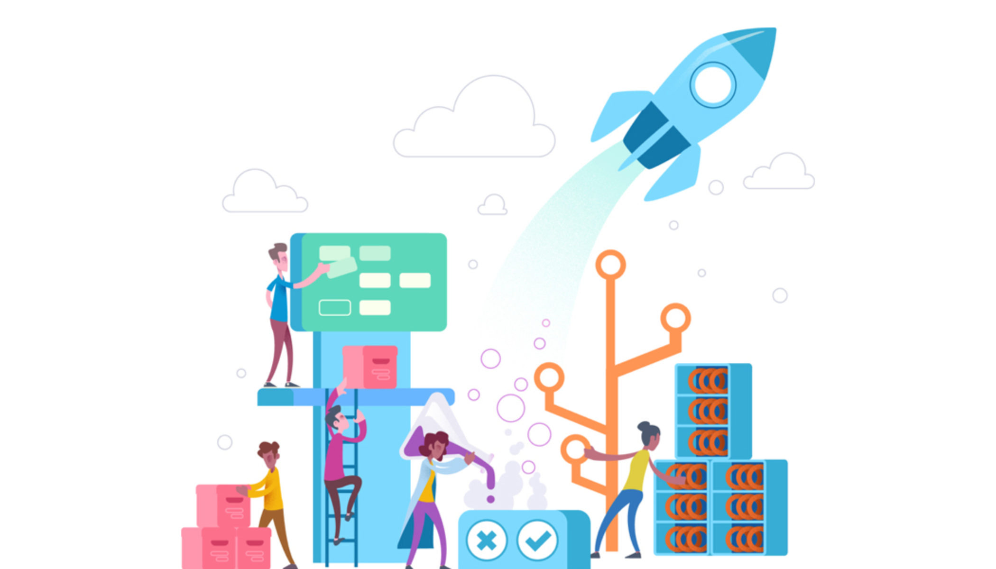
Azure Boards
Azure Boards
Deliver value to your users faster using agile tools to plan, track, and discuss work across your teams.

Slide 9
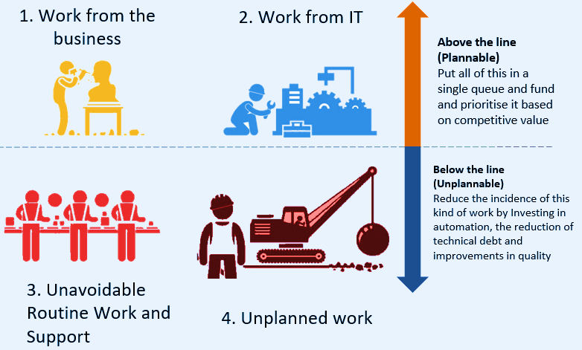
The 4 Types of Work

Slide 10
What are Work Items?
Work items are the foundation for all tracking, monitoring and reporting of value that flows through the system.
Work Item Types:
Epic
Feature
User Story
Task

Slide 11
Work Item Hierarchy
Tasks
User Stories
Features
Epics

Slide 12
User Stories
A unit of value that we deliver to the organization
Outcome Focused
Comprised of the Who, What, Why and Acceptance Criteria
A promise to have a conversation
Helps to create a simplified description of a requirement.
Shows a clear, meaningful, and achievable accomplishment
Generally estimated in story points, seldom in hours
Made up of tasks
Notes:
The Card - A 3x5 index card forces brevity. Only capture the topic of the item, a high level description of the desired system behavior, and why it is important.
The Conversation - A User Story it not enough. Consider it a placeholder for conversation. Detailed requirements are only discovered once the story has been targeted for a sprint.
The Confirmation - On the back of the card capture Acceptance Criteria. They outline specifications from the Product Owner and will allow the team build functionality for acceptance.

Slide 13
User Story Examples
Put up 7 fence panels in the backyard,
so that our dog doesn’t keep getting out.
Upgrade switch EXAMPLE01 at Tulsa Datacenter, so that we can reduce the risk of a vulnerability that is in the current software version.
Create a Runbook that can send the Treasury Exchange Log Report from any Deployment Pool, so that we can version control and move it off of the “edcacsomv001” server.
Create a continuous view of the 8414 Log
in the Compression Services App, so that
a user does not have to click on small tabs
in the field.

Slide 14
Story Points
A unit of measure for expressing an estimate of the overall effort that will be required to fully implement a product backlog item or any other piece of work.
Provide a way for teams to properly estimate how fast they can complete work in the system.
When we estimate with story points, we assign a point value to each item.
Notes:
“Estimates of work can range from 400 percent beyond the time actually taken to 25 percent of the time taken. The low and high estimates differ by a factor of sixteen. As the project progresses and more and more gets settled, the estimates fall more and more into line with reality until there are no more estimates, only reality.” – Jeff Sutherland
Understanding sizing helps us know how fast a piece of value can flow through the system.
It is unique to each team, but the scale stays the same.

Slide 15
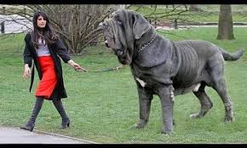
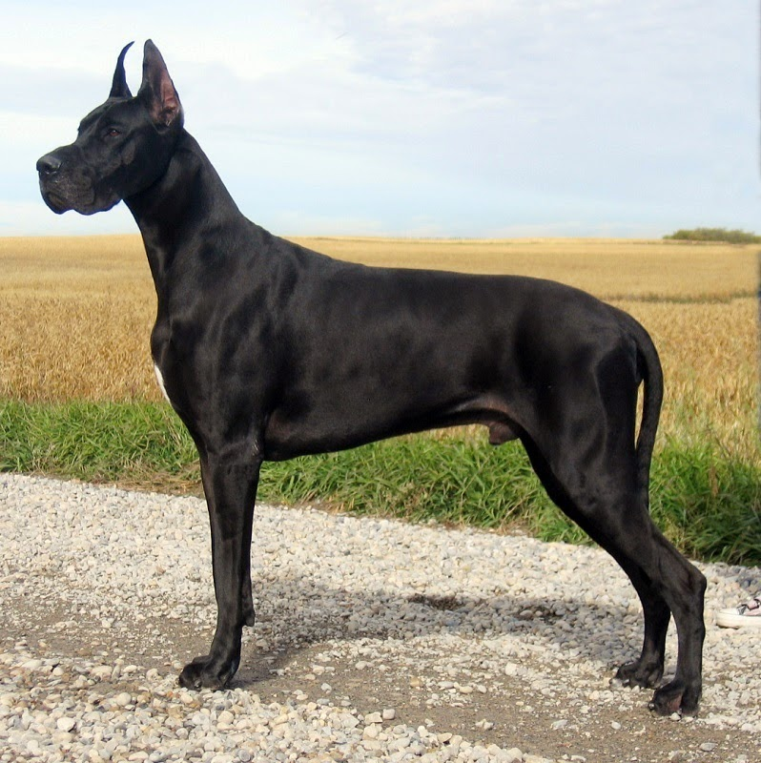
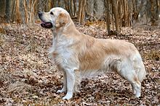
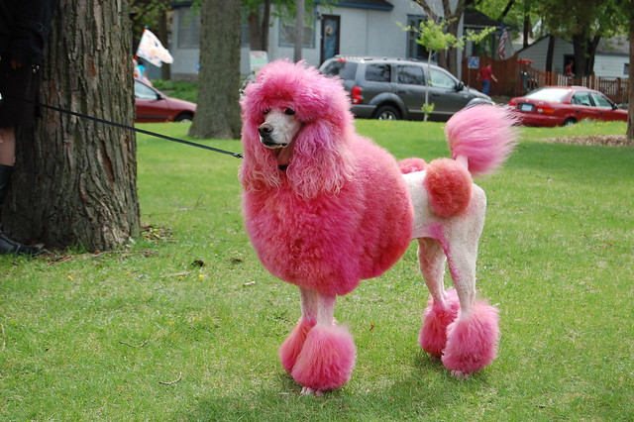

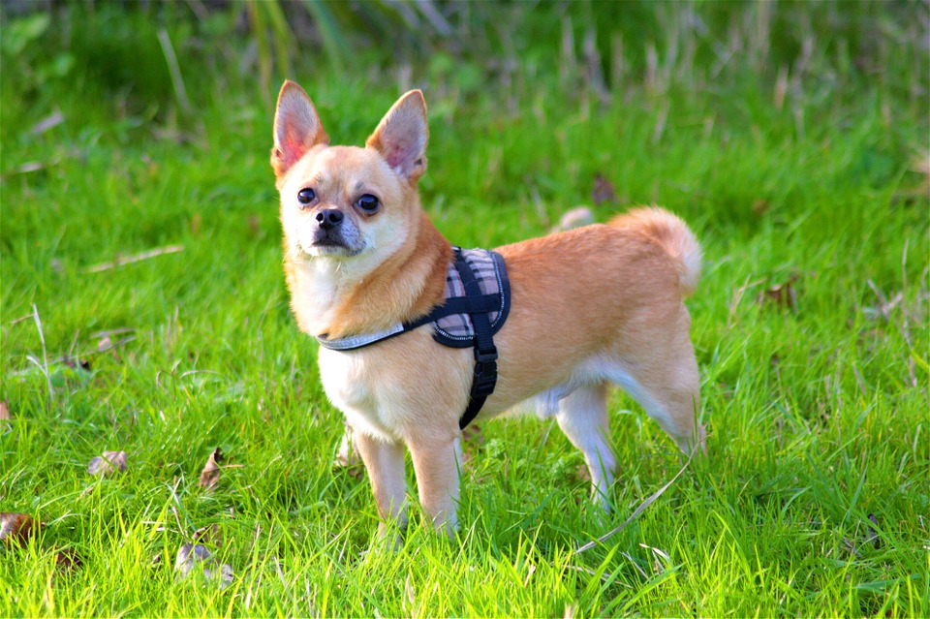
Story Point Sizing
We think that work is a poodle, and we know that poodles are generally done in less than 4 days, so we believe that work will be done this week.
That looks like a Great Dane. We will need around 4 weeks to complete that.
The raw values of each individual item are unimportant,
but the relative size of one story to another defines its
priority and duration.
Uses a Fibonacci –like Format
1, 2, 3, 5, 8, 13, 20, (20+ should be an Epic)
20
13
8
5
3
1
Notes:
Epic – Make our backyard a welcoming space.
Feature – Fix the fence
User Stories –
Make sure the fence has a strong base, so that it does not fall in severe weather - 5
Put up 7 fence panels, so that we can have privacy with our family and friends - 8
Determine the type of fence panels we want, so that we have a consistent color pattern and architectural style. - 3

Slide 16
Acceptance Criteria
Every user story must have at least one acceptance criteria
Identified before work begins
Each point is independently testable
Must have a clear Pass/Fail result
Includes functional and non-functional criteria
Examples:
The PowerShell function runs from three
different deployment pools without an error.
The switch allows traffic to pass from
subnet A to subnet B for https traffic.

Slide 17
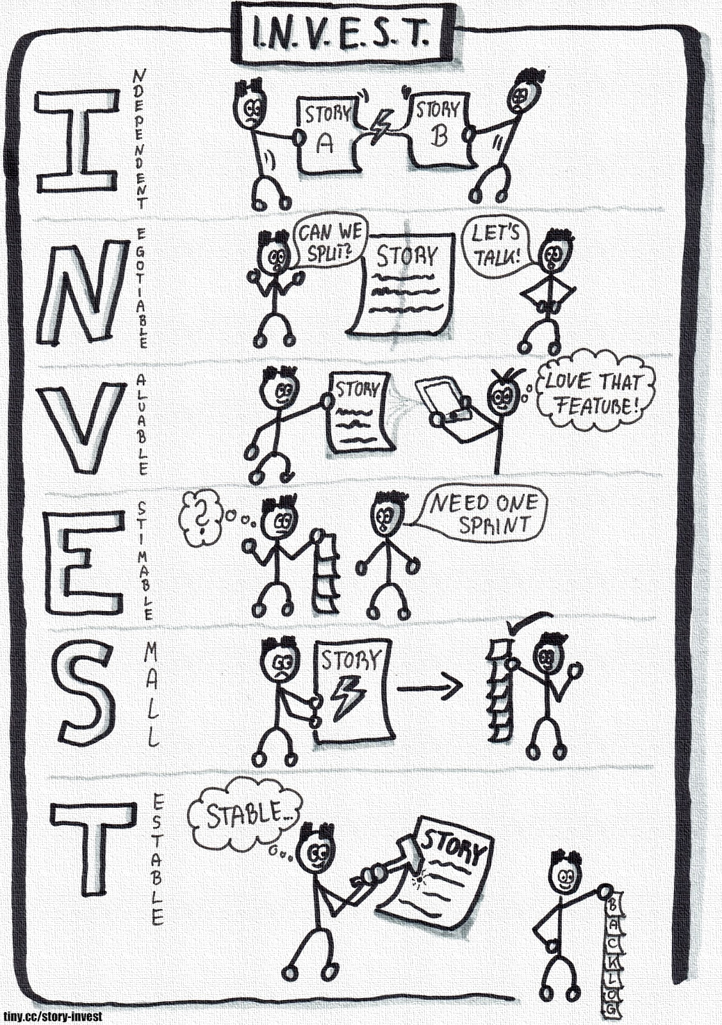
I.N.V.E.S.T
Independent
Negotiable
Valuable
Estimable
Small
Testable

Slide 18
Tasks
Concrete work to be performed by a team member.
Typically estimated in hours.
Provides a clear status of the tangible work that is being accomplished in the overall story/project
Should not generally contain an “and” statement
Task Examples
Buy concrete for the fence
Create an automation account
Obtain upgraded software package
Deploy Docker to Linux Host
Ship switch to Houston

Slide 19
Features
In its simplest form, a feature is a specific bucket for a set of user stories.
Should be clearly linked to value for the organization.
Defined as characteristics or events of the product or service.
Typically estimated in weeks, not days.
Usually separates one version of a product from the next.
Generally made up of User Stories.
Examples:
Put up a fence in the backyard.
Add new switches to the Houston Datacenter.
Move scheduled tasks off of edcacsomv001
to Azure Runbooks.

Slide 20
Epics
Represents a series of user stories that share a broader strategic objective.
Typically estimated in months, not weeks.
Generally made up of Features
Examples:
Create a welcoming outdoor space
for my friends
Migrate all network configurations to definition
files within Azure DevOps.
Create a Client Solutions API that other teams
could use in order to complete requests
Create a way for the SMTP relay
to live in a Docker Image that
runs through a Pipeline

Slide 21
Decomposing Stories
Tasks
Hours
User Stories
Days
Features
Weeks
Epics
Months

Slide 22
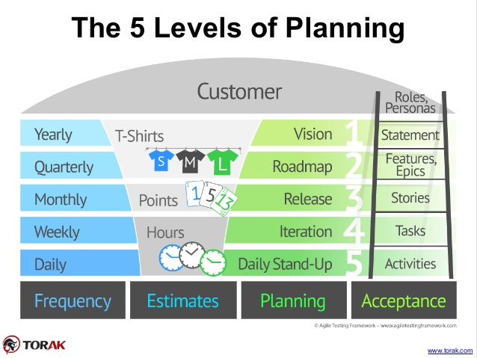
The Five Levels of Planning

Slide 23
Demo Time!

Slide 24
Questions?

Slide 25
Make Work Visible!
DEV
OPS
Production

